Slide 1
Fuzzy Logic
Colter McClure

Slide 2
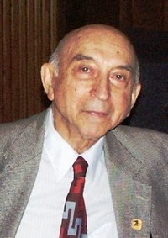
Origin of Fuzzy Logic
Studied since 1920
First described by Lotfi Zadeh in 1965
Lotfi Zadeh

Slide 3
What is Fuzzy Logic
Degrees of truth
Three Steps
Fuzzify all input values into fuzzy membership functions
Execute all applicable rules in the rulebase to compute the fuzzy output functions
De-fuzzify the fuzzy output functions to get "crisp" output values

Slide 4
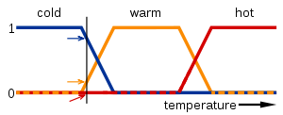
Fuzzy Logic Example

Slide 5
Defuzzification
For each truth value, cut the membership function at this value
Combine the resulting curves using the OR operator
Find the center-of-weight of the area under the curve
The x position of this center is then the final output

Slide 6
Fuzzy Sets
Sets designed to hold degrees of truth
A 0 represents exclusion from the set
A1 represents a fully included value in the set
Any value between 0 and 1 is partially included in the set the closer the value is to 1 the more it is included in the set.

Slide 7
Uses of Fuzzy Logic
Fuzzy Logic Control Systems
Machine Learning
Neural Networks
Computing with Words

